Slide 1
CS3391 Object Oriented Programming
Dr.D.Sivaganesan, Professor,
PSGiTech / CSE

Slide 2
Synchronizing Threads
Synchronization in java is the capability to control the access of multiple threads to any shared
resource.
Java Synchronization is better option where we want to allow only one thread to access the shared
resource
General Syntax :
synchronized(object)
{ //statement to be synchronized }
Why use Synchronization
The synchronization is mainly used to
To prevent thread interference.
To prevent consistency problem.
Types of Synchronization
Process Synchronization
Thread Synchronization
Thread Synchronization
There are two types of thread synchronization mutual exclusive and inter-thread communication.
1. Mutual Exclusive
Synchronized method.
Synchronized block.
Static synchronization.
2.Cooperation (Inter-thread communication in java)

Slide 3
Synchronized method
If you declare any method as synchronized, it is known as
synchronized method.
Synchronized method is used to lock an object for any shared
resource.
When a thread invokes a synchronized method, it automatically
acquires the lock for that object and releases it when the thread
completes its task.
Syntax:
public synchronized void methodname (args)
{
//statement to be synchronized
}

Slide 4
class share
{
public synchronized void doword(String str)
{for (int i = 0; i < 5; i++)
{System.out.println("Started:" + str);
try
{Thread.sleep(1000);}
catch (Exception e)
{}}}}
class MyThread extends Thread
{ share s;
MyThread(share s, String str)
{ super(str);
this.s = s;
start(); }
public void run()
{
s.doword(Thread.currentThread().getName());}}
public class sthread
{
public static void main(String args[])
{
share s = new share();
MyThread m1 = new MyThread(s, "Thread1");
MyThread m2 = new MyThread(s, "Thread2");
MyThread m3 = new MyThread(s, "Thread3");
}}

Slide 5
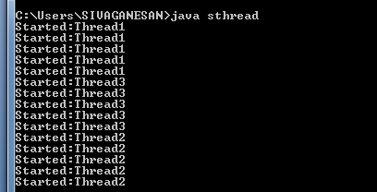

Slide 6
Synchronized block
Synchronized block can be used to perform synchronization on any specific resource of the method.
Suppose you have 50 lines of code in your method, but you want to synchronize only 5 lines, you can use synchronized block.
If you put all the codes of the method in the synchronized block, it will work same as the synchronized method.
Syntax:
public void methodname (args)
{
synchronized(this)
{
//statement to be synchronized
}
}

Slide 7
class Table{
void printTable(int n)
{ synchronized(this)
{//synchronized block
for(int i=1;i<=5;i++){
System.out.println(n*i);
Try{Thread.sleep(400);}
catch(Exception e)
{System.out.println(e);}}
for(int i=1;i<=5;i++){
System.out.println(i); }}
}//end of the method}
class MyThread1 extends Thread{
Table t;
MyThread1(Table t){
this.t=t;start();
}
public void run(){
t.printTable(5); }}
class MyThread2 extends Thread{
Table t;
MyThread2(Table t){
this.t=t;start();
}
public void run(){
t.printTable(100);
}
}
public class sbthread
{
public static void main(String args[]){
Table obj = new Table();//only one object
MyThread1 t1=new MyThread1(obj);
MyThread2 t2=new MyThread2(obj);
}
}

Slide 8
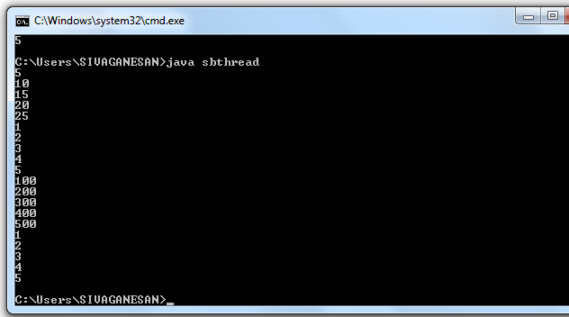

Slide 9
Static synchronization
If you make any static method as synchronized, the lock will be on the class not on object.
Syntax:
public synchronized static void methodname (args)
{
//statement to be synchronized
}

Slide 10
class Table{
synchronized static void printTable(int n)
{ for(int i=1;i<=10;i++)
{System.out.println(n*i);
try{
Thread.sleep(400);
}catch(Exception e){}}}}
class MyThread1 extends Thread{
public void run(){
Table.printTable(1);
}}
class MyThread2 extends Thread{
public void run(){
Table.printTable(10);
}}
class MyThread3 extends Thread{
public void run(){
Table.printTable(100);
}}
class MyThread4 extends Thread{
public void run(){
Table.printTable(1000);
}}
public class ssthread
{
public static void main(String t[]){
MyThread1 t1=new MyThread1();
MyThread2 t2=new MyThread2();
MyThread3 t3=new MyThread3();
MyThread4 t4=new MyThread4();
t1.start();
t2.start();
t3.start();
t4.start();}}

Slide 11


Slide 12
Inter-thread communication
Inter-thread communication or Co-operation is all about allowing synchronized threads to communicate with each other.
Inter-thread communication is a mechanism in which a thread is paused running in its critical section and another thread is allowed to enter (or lock) in the same critical section to be executed.It is implemented by following methods of Object class:
wait() notify() notifyAll() join()
wait()
tells calling thread to give up monitor and go to sleep until some other thread enters the same monitor and call notify.
notify()
wakes up a thread that called wait() on same object.
notifyAll()
wakes up all the thread that called wait() on same object.
join()
waits for a thread to die. In other words, it causes the currently running threads to stop executing until the thread it joins with completes its task.

Slide 13
wait() | sleep()
wait() method releases the lock | sleep() method doesn't release the lock.
is the method of Object class | is the method of Thread class
is the non-static method | is the static method
should be notified by notify() or notifyAll() methods | after the specified amount of time, sleep is completed.

Slide 14
class Customer{
int amount=10000;
synchronized void withdraw(int amount)
{
System.out.println("going to withdraw...");
if(this.amount<amount)
{
System.out.println("Less balance; waiting for deposit..."+this.amount);
try{
wait();
}catch(Exception e)
{ } }
this.amount-=amount;
System.out.println("withdraw completed..."+this.amount);}
synchronized void deposit(int amount)
{ System.out.println("going to deposit...");
this.amount+=amount;
System.out.println("deposit completed...
"+this.amount); notifyAll();}}
class exitc{
public static void main(String args[])throws InterruptedException
{final Customer c=new Customer();
Thread t1=new Thread()
{ public void run(){c.withdraw(15000);
} };
Thread t2=new Thread(){
public void run(){
c.deposit(10000);}
};
t1.start();
t2.start();
t1.join();
t2.join();
}}

Slide 15


Slide 16
Thank you

